Slide 1


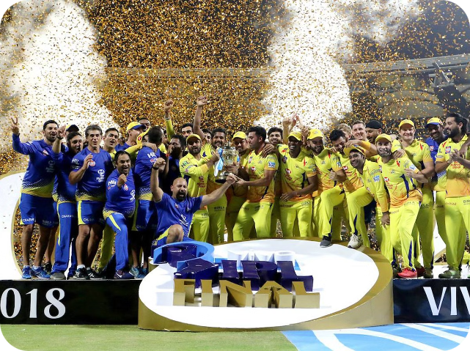

IPL Data Analysis
Explore the rich dataset of the Indian Premier League, one of the most popular cricket tournaments in the world. Uncover insights into player performances, team strategies, and trends that shape the thrilling IPL seasons.
by DADASO PATIL

Slide 2

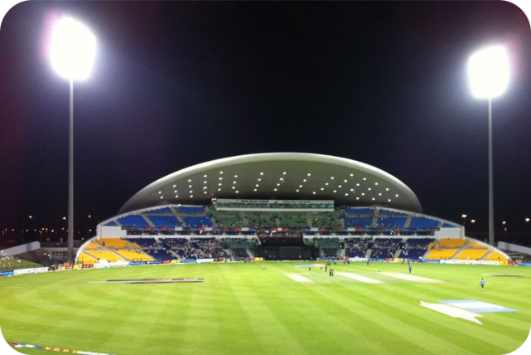
Overview of the Indian Premier League
1
Explosive Cricket
2
Talent Showcase
The IPL is known for its fast-paced, high-scoring matches that captivate audiences worldwide.
The tournament provides a platform for both international and domestic cricket stars to showcase their skills.
3
Franchise Model
The league is structured around city-based franchises, each with their own unique fan following and strategies.

Slide 3

Data Collection and Preprocessing
Gather Data
Enrich with Context
Collect match records, player statistics, and other relevant data from official IPL sources.
Supplement the data with additional information like team rosters, venue details, and weather conditions.
1
2
3
Clean and Preprocess
Handle missing values, fix data inconsistencies, and transform the data into a format suitable for analysis.

Slide 4
Exploratory Data Analysis
Match Statistics
Player Performances
Venue Dynamics
Analyze trends in match outcomes, run rates, and other in-game metrics to uncover patterns and anomalies.
Dive deep into individual player statistics, including batting, bowling, and fielding performances.
Investigate how factors like pitch conditions and weather impact the gameplay and outcomes.

Slide 5


Player Performance Insights
1
Batting Leaders
2
Bowling Dominance
Identify the most consistent run-scorers and recognize emerging batting talents.
Analyze the top wicket-takers and understand the strategies behind their success.
3
All-Rounders Shine
4
Breakthrough Performances
Spotlight the versatile players who excel in both batting and bowling disciplines.
Uncover the rising stars who have made a significant impact in recent IPL seasons.

Slide 6

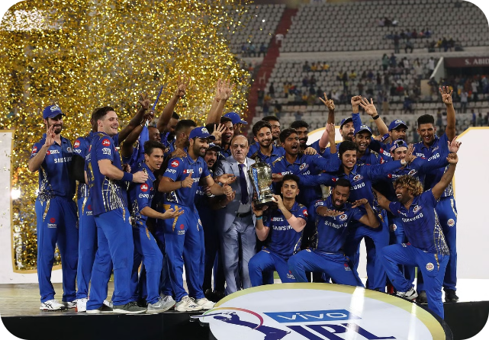
Team Strategies and Trends
Batting Approaches
Bowling Tactics
Analyze how teams adapt their batting lineups and strategies to different match situations.
Understand the various bowling combinations and strategies employed by successful IPL teams.
Squad Composition
Captaincy Impact
Examine how teams balance their rosters with the right mix of international and domestic players.
Explore the influential role of team captains in shaping their squad's performance and morale.

Slide 7


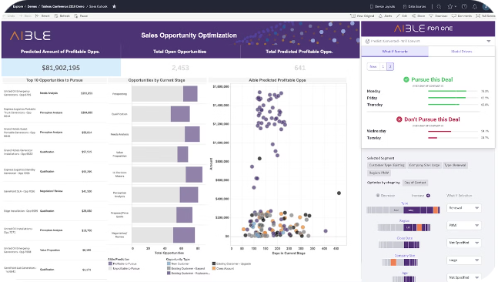


Predictive Modeling and Forecasting
Feature Engineering
Identify the most relevant features from the data to build accurate predictive models.
Model Training
Apply advanced machine learning techniques to forecast match outcomes and player performances.
Performance Evaluation
Assess the accuracy and reliability of the predictive models through rigorous testing.

Slide 8


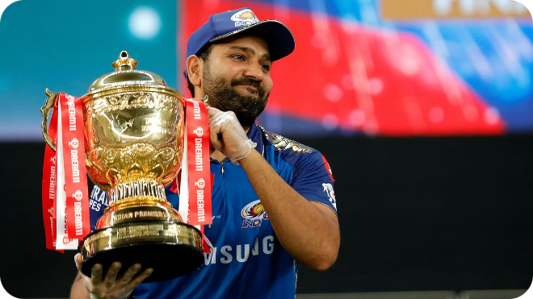


Conclusion and Recommendations
Key Insights
Summarize the most valuable insights gained from the comprehensive data analysis.
Strategic Recommendations
Provide actionable recommendations to help teams, players, and stakeholders improve their performance.
Future Opportunities
Identify areas for further research and explore how data analytics can shape the future of the IPL.

